Slide 1

CSE 473: Pattern Recognition

Slide 2
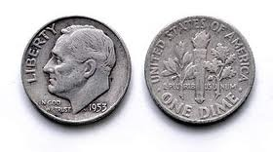
Hidden Markov Model

Slide 3
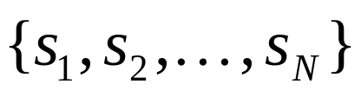
Markov Models
Set of states:

Slide 4
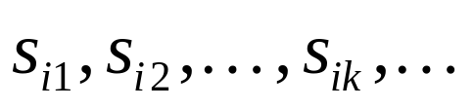
Markov Models
Set of states:
Process moves from one state to another generating a sequence of states :

Slide 5
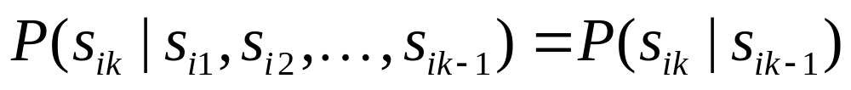
Markov Models
Set of states:
Process moves from one state to another generating a sequence of states :
Markov chain property: probability of each subsequent state depends only on what was the previous state:

Slide 6
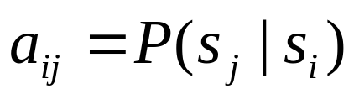
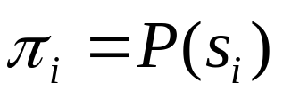
Markov Models
Set of states:
Process moves from one state to another generating a sequence of states :
Markov chain property: probability of each subsequent state depends only on what was the previous state:
To define Markov model, the following probabilities have to be specified: transition probabilities and initial probabilities

Slide 7
Example of Markov Model
0.3
0.7
Rain
Dry
0.2
0.8

Slide 8
Example of Markov Model
0.3
0.7
Rain
Dry
0.2
0.8
Two states : ‘Rain’ and ‘Dry’.

Slide 9
Example of Markov Model
0.3
0.7
Rain
Dry
0.2
0.8
Two states : ‘Rain’ and ‘Dry’.
Transition probabilities:
  P(‘Rain’|‘Rain’)=0.3 , P(‘Dry’|‘Rain’)=0.7 ,
  P(‘Rain’|‘Dry’)=0.2, P(‘Dry’|‘Dry’)=0.8

Slide 10
Example of Markov Model
0.3
0.7
Rain
Dry
0.2
0.8
Two states : ‘Rain’ and ‘Dry’.
Transition probabilities:
  P(‘Rain’|‘Rain’)=0.3 , P(‘Dry’|‘Rain’)=0.7 ,
  P(‘Rain’|‘Dry’)=0.2, P(‘Dry’|‘Dry’)=0.8
Initial probabilities: say P(‘Rain’)=0.4 , P(‘Dry’)=0.6 .

Slide 11
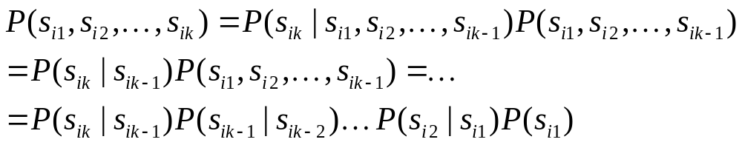
Calculation of sequence probability
By Markov chain property, probability of state sequence can be found by the formula:

Slide 12
Calculation of sequence probability
0.3
0.7
Rain
Dry
0.2
0.8
Suppose we want to calculate a probability of a sequence of states in our example, {‘Dry’,’Dry’,’Rain’,Rain’}.
P({‘Dry’,’Dry’,’Rain’,Rain’} )

Slide 13
Calculation of sequence probability
0.3
0.7
Rain
Dry
0.2
0.8
Suppose we want to calculate a probability of a sequence of states in our example, {‘Dry’,’Dry’,’Rain’,Rain’}.
P({‘Dry’,’Dry’,’Rain’,Rain’} )
= P(‘Rain’|’Rain’) P(‘Rain’|’Dry’) P(‘Dry’|’Dry’) P(‘Dry’)

Slide 14
Calculation of sequence probability
0.3
0.7
Rain
Dry
0.2
0.8
Suppose we want to calculate a probability of a sequence of states in our example, {‘Dry’,’Dry’,’Rain’,Rain’}.
P({‘Dry’,’Dry’,’Rain’,Rain’} )
= P(‘Rain’|’Rain’) P(‘Rain’|’Dry’) P(‘Dry’|’Dry’) P(‘Dry’)
= 0.3*0.2*0.8*0.6

Slide 15
Hidden Markov Model

Slide 16
Hidden Markov Model

Slide 17
Hidden Markov Model
H T H H T T T H H H . . . . .

Slide 18
Hidden Markov Model
H T H H T T T H H H . . . . .
Can we guess which coin is tossed at different times?

Slide 19
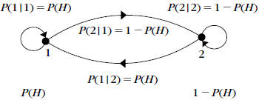
Not A Hidden Markov Model

Slide 20
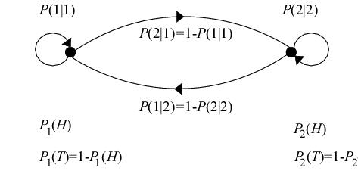
Hidden Markov Model

Slide 21
Hidden Markov models
Set of states:
Process moves from one state to another generating a sequence of states :
Markov chain property: probability of each subsequent state depends only on what was the previous state:

Slide 22
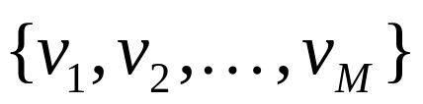
Hidden Markov models
States are not visible, but each state randomly generates one of M observations (or visible states)

Slide 23
Hidden Markov models
States are not visible, but each state randomly generates one of M observations (or visible states)
To define hidden Markov model, the following probabilities have to be specified:
  matrix of transition probabilities A=(a_{ij}), a_{ij}= P(s_{j} | s_{i})
  matrix of observation probabilities B=(b_{i} (v_{m} )),
  where, b_{i}(v_{m} ) =P(v_{m}|s_{i})
  vector of initial probabilities π=(π_{i}), π_{i} = P(s_{i})
Model is represented by M=(A, B, π).

Slide 24
Example of Hidden Markov Model
0.3
0.7
Low
High
0.2
0.8
0.6
0.6
0.4
0.4
Rain
Dry

Slide 25
Example of Hidden Markov Model
0.3
0.7
Low
High
0.2
0.8
0.6
0.6
0.4
0.4
Rain
Dry
Initial probabilities: say P(‘Low’)=0.4 , P(‘High’)=0.6 .

Slide 26
Example of Hidden Markov Model
Two states : ‘Low’ and ‘High’ atmospheric pressure.
Two observations : ‘Rain’ and ‘Dry’.
Transition probabilities: P(‘Low’|‘Low’)=0.3 , P(‘High’|‘Low’)=0.7 , P(‘Low’|‘High’)=0.2, P(‘High’|‘High’)=0.8
Observation probabilities : P(‘Rain’|‘Low’)=0.6 , P(‘Dry’|‘Low’)=0.4 , P(‘Rain’|‘High’)=0.4 , P(‘Dry’|‘High’)=0.3 .
Initial probabilities: say P(‘Low’)=0.4 , P(‘High’)=0.6 .

Slide 27
Calculation of observation sequence probability
Suppose we want to calculate a probability of a sequence of observations in our example, {‘Dry’,’Rain’}.
Consider all possible hidden state sequences:
P({‘Dry’,’Rain’} ) = P({‘Dry’,’Rain’} , {‘Low’,’Low’})
+P({‘Dry’,’Rain’} , {‘Low’,’High’})
+ P({‘Dry’,’Rain’} , {‘High’,’Low’})
+ P({‘Dry’,’Rain’} , {‘High’,’High’})

Slide 28
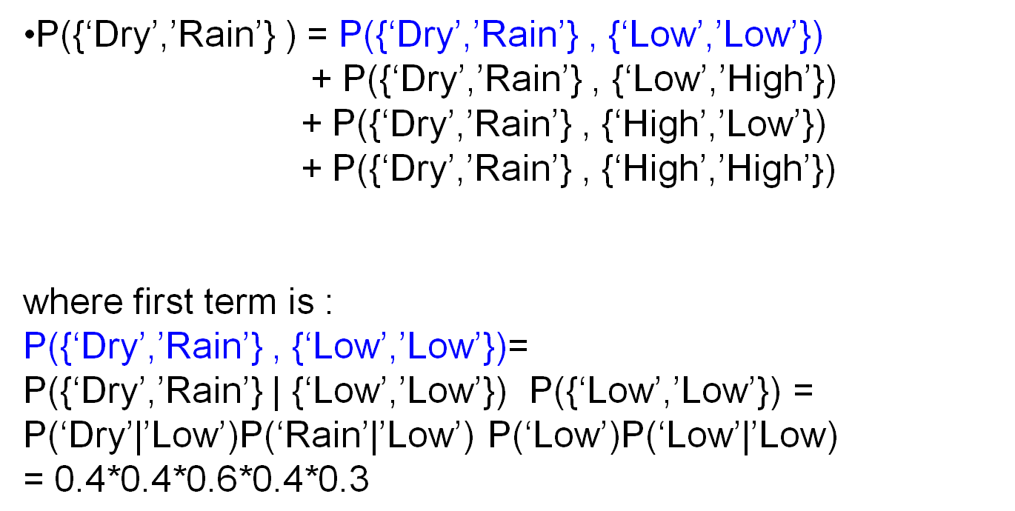
Calculation of observation sequence probability

Slide 29
Main issues using HMMs
Evaluation problem.
Given the HMM M=(A, B, π) and the observation sequence O=o₁ o₂ ... o_{K} , calculate the probability that model M has generated sequence O.
O=o₁...o_{K} denotes a sequence of observations o_{k}∈{v₁,…,v_{M}}.

Slide 30
Main issues using HMMs
Decoding problem.
Given the HMM M=(A, B, π) and the observation sequence O=o₁ o₂ ... o_{K} , calculate the most likely sequence of hidden states s_{i} that produced this observation sequence O.
O=o₁...o_{K} denotes a sequence of observations o_{k}∈{v₁,…,v_{M}}.

Slide 31
Main issues using HMMs
Learning problem.
Given some training observation sequences O=o₁ o₂ ... o_{K} and general structure of HMM (numbers of hidden and visible states), determine HMM parameters M=(A, B, π) that best fit training data.
O=o₁...o_{K} denotes a sequence of observations o_{k}∈{v₁,…,v_{M}}.

Slide 32
The evaluation Problem
Given the HMM M=(A, B, π) and the observation sequence O=o₁ o₂ ... o_{K} , calculate the probability that model M has generated sequence O.
where, O=o₁...o_{K} denotes a sequence of observations o_{k}∈{v₁,…,v_{M}}.

Slide 33
The evaluation Problem
Given the HMM M=(A, B, π) and the observation sequence O=o₁ o₂ ... o_{K} , calculate the probability that model M has generated sequence O.
where, O=o₁...o_{K} denotes a sequence of observations o_{k}∈{v₁,…,v_{M}}.
Alternately, find P(O|M) or P(o₁ o₂ ... o_{K}|M)

Slide 34
The evaluation Problem
Given the HMM M=(A, B, π) and the observation sequence O=o₁ o₂ ... o_{K} , calculate the probability that model M has generated sequence O.
where, O=o₁...o_{K} denotes a sequence of observations o_{k}∈{v₁,…,v_{M}}.
Alternately, find P(O|M) or P(o₁ o₂ ... o_{K}|M)
For simplicity we write it as P(O) or P(o₁ o₂ ... o_{K})

Slide 35
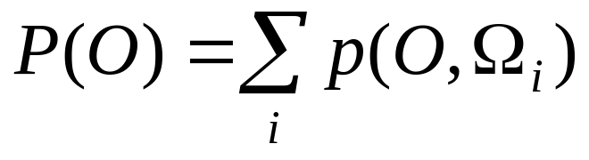
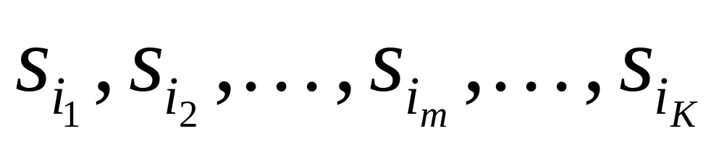
The evaluation Problem
Objective:
find P(O) or P(o₁ o₂ ... o_{K})
where, Ω_{i} is a possible state sequence

Slide 36
The evaluation Problem
Objective:
find P(O) or P(o₁ o₂ ... o_{K})
where, Ω_{i} is a possible state sequence
There are N^{K} possible state sequences!!

Slide 37
The evaluation Problem
Objective:
find P(O) or P(o₁ o₂ ... o_{K})
where, Ω_{i} is a possible state sequence
Complexity is O(N^{K} )

Slide 38
Alternate Solution to The evaluation Problem
Use Forward-Backward HMM algorithms for efficient calculations.
Define the forward variable α_{m}(i) as the joint probability of
  the partial observation sequence o₁ o₂ ... o_{m} and
  the hidden state at time m is s_{i} :
α_{m}(i)= P(o_{1,} o₂ ... o_{m ,} q_{m}= s_{i} )

Slide 39
Trellis representation of an HMM
o₁ o_{m} o_{m+1} o_{K} = Observations
s₁
s₁
s₁
s₁
s₂
s₂
a_{1j}
s₂
s₂
a_{2j}
s_{i}
s_{i}
a_{ij}
s_{i}
s_{j}
a_{Nj}
s_{N}
s_{N}
s_{N}
s_{N}
Time= 1 m m+1 K

Slide 40
Trellis representation of an HMM
o₁ o_{m} o_{m+1} o_{K} = Observations
s₁
α_{m}(1)
s₁
s₁
a_{1j}
s₂
α_{m}(2)
s₂
s₂
a_{2j}
s_{i}
α_{m}(i)
s_{i}
a_{ij}
α_{m+1}(j)
a_{Nj}
s_{N}
α_{m}(N)
s_{N}
s_{N}
Time= 1 m m+1 K

Slide 41
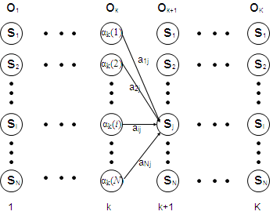
Trellis representation of an HMM
o_{m}
O_{m+1}
Therefore, we can write,
α_{m+1}(j)= P(o₁ o₂ ... o_{m+1 ,} q_{m+1}= s_{j} )
=Σ_{i} P(o₁ o₂ ... o_{m+1 ,}q_{m}= s_{i ,} q_{m+1}=s_{j})
=Σ_{i} P(o₁ o₂ ...o_{m ,} q_{m}= s_{i}) a_{ij} b_{j} (o_{m+1} )
=[Σ_{i} α_{m}(i) a_{ij} ] b_{j} (o_{m+1} ) ,
for 1<=j<=N, 1<=m<=K-1.
m
m+1

Slide 42
Trellis representation of an HMM
o_{m}
O_{m+1}
m
m+1
Now P(o₁ o₂ ... o_{K})
can be written as Σ_{i} P(o₁ o₂ ... o_{K ,} q_{K}= s_{i}) = Σ_{i} α_{K}(i)

Slide 43
Forward recursion for HMM
Initialization:
α₁(i)= P(o_{1 ,} q₁= s_{i} ) = π_{i} b_{i} (o₁) , 1<=i<=N.
Forward recursion:
α_{m+1}(j) = [Σ_{i} α_{m}(i) a_{ij} ] b_{j} (o_{m+1} ) , 1<=j<=N, 1<=m<=K-1.
Termination:
P(o₁ o₂ ... o_{K}) = Σ_{i} α_{K}(i)
Complexity :
N²K operations.

Slide 44
Backward recursion for HMM
Define the backward variable β_{m}(j) as the conditional probability of
  the partial observation sequence o_{m+1} o_{m+2} ... o_{K}
  given that the hidden state at time m is s_{j} :
  β_{m}(j)= P(o_{m+1} o_{m+2} ... o_{K} |q_{m}= s_{j} )

Slide 45
Backward recursion for HMM
Define β_{m}(j) in terms of β_{m+1}(i)’s:
β_{m+1}(i) is the conditional probability of
  the partial observation sequence o_{m+2} o_{m+3} ... o_{K}
  given that the hidden state at time m+1 is s_{i} :
  β_{m+1}(i)= P(o_{m+2} o_{m+3} ... o_{K} |q_{m+1}= s_{i} )

Slide 46
Backward recursion for HMM
Define β_{m}(j) in terms of β_{m+1}(i)’s: the probability of
where β_{m+1}(i)= P(o_{m+2} o_{m+3} ... o_{K} |q_{m+1}= s_{i} )
Now,
β_{m}(j)= P(o_{m+1} o_{m+2} ... o_{K} | q_{m}= s_{j} )
= Σ_{i} P(o_{m+1} o_{m+2} ... o_{K ,} q_{m+1}= s_{i} | q_{m}= s_{j} )
= Σ_{i} P(o_{m+2} o_{m+3} ... o_{K} | q_{m+1}= s_{i}) a_{ji} b_{i} (o_{m+1} )
= Σ_{i} β_{m+1}(i) a_{ji} b_{i} (o_{m+1} ) , 1<=j<=N, 1<=m<=K-1.

Slide 47
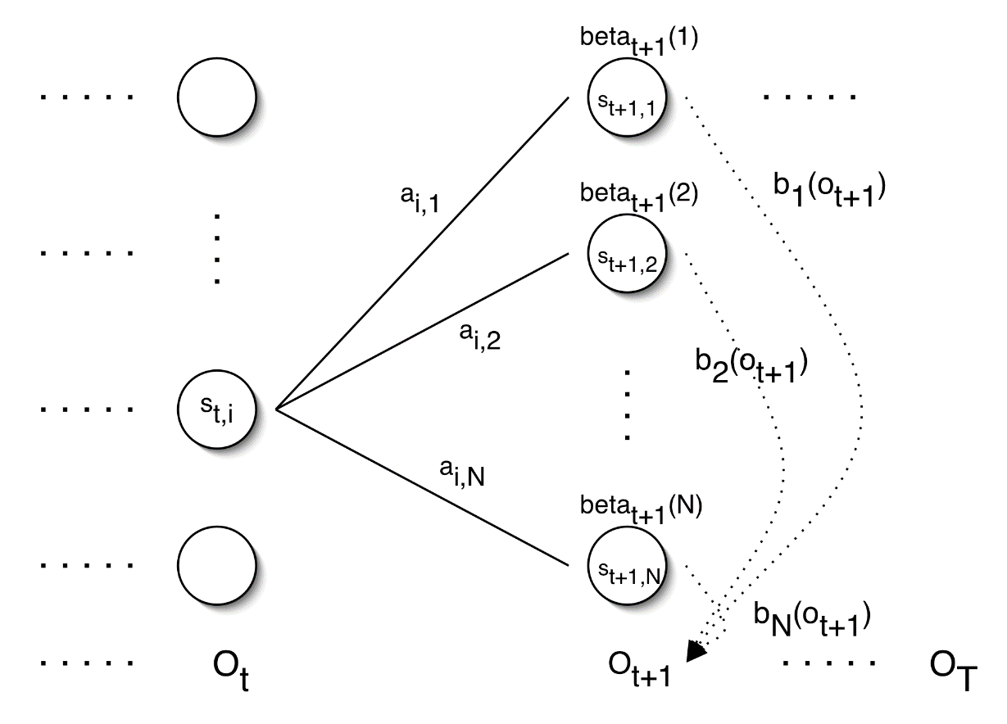
Backward recursion for HMM
= Σ_{i} P(o_{m+1} o_{m+2} ... o_{K ,} q_{m+1}= s_{i} | q_{m}= s_{j} )
= Σ_{i} P(o_{m+2} o_{m+3} ... o_{K} | q_{m+1}= s_{i}) a_{ji} b_{i} (o_{m+1} )
= Σ_{i} β_{m+1}(i) a_{ji} b_{i} (o_{m+1} ) , 1<=j<=N, 1<=m<=K-1.
β_{m+1}(1)
b₁(O_{m+1})
β_{m+1}(2)
b₂(O_{m+1})
β_{m}(j)
β_{m+1}(N)
b_{N}(O_{m+1})
o_{m}
O_{m+1}
o_{K}

Slide 48
Backward recursion for HMM
Initialization:
β_{K}(i)= 1 , 1<=i<=N.
Backward recursion:
β_{m}(j)= Σ_{i} β_{m+1}(i) a_{ji} b_{i} (o_{m+1} ) , 1<=j<=N, 1<=m<=K-1.
Termination:
P(o₁ o₂ ... o_{K}) = Σ_{i} P(o₁ o₂ ... o_{K ,} q₁= s_{i}) =
Σ_{i} P(o₁ o₂ ... o_{K} |q₁= s_{i}) P(q₁= s_{i}) = Σ_{i} β₁(i) b_{i} (o₁) π_{I}

Slide 49
Main issues using HMMs (2)
Decoding problem.
Given the HMM M=(A, B, π) and the observation sequence O=o₁ o₂ ... o_{K} , calculate the most likely sequence of hidden states s_{i} that produces this observation sequence O.
O=o₁...o_{K} denotes a sequence of observations o_{k}∈{v₁,…,v_{M}}.

Slide 50
Decoding problem
Given the HMM M=(A, B, π) and the observation sequence O=o₁ o₂ ... o_{K} , calculate the most likely sequence of hidden states s_{i} that produces this observation sequence O.
We want to find:
the state sequence Q= q₁…q_{K} maximizing
P(Q | o₁ o₂ ... o_{K} )

Slide 51
Decoding problem
Given the HMM M=(A, B, π) and the observation sequence O=o₁ o₂ ... o_{K} , calculate the most likely sequence of hidden states s_{i} that produces this observation sequence O.
We want to find:
the state sequence Q= q₁…q_{K} maximizing
P(Q | o₁ o₂ ... o_{K} )
or, equivalently
P(Q , o₁ o₂ ... o_{K} )

Slide 52
Decoding problem
Find max value of P(Q , o₁ o₂ ... o_{K} )
Brute Force Method:
Try for all possible sequences of states
N^{K} possible sequences for Q

Slide 53
Decoding problem
Use efficient Viterbi algorithm instead
Define variable δ_{m}(i) as the maximum probability of
  producing observation sequence o₁ o₂ ... o_{m}
  when moving along any hidden state sequence q₁… q_{m-1} and
  getting into q_{m}= s_{i}

Slide 54
Decoding problem
Use efficient Viterbi algorithm instead
Define variable δ_{m}(i) as the maximum probability of
  producing observation sequence o₁ o₂ ... o_{m}
  when moving along any hidden state sequence q₁… q_{m-1} and
  getting into q_{m}= s_{i}
Therefore, δ_{m}(i) = max P(q₁… q_{m-1} , q_{m}= s_{i} , o₁ o₂ ... o_{m})
where max is taken over all possible paths q₁… q_{m-1} .

Slide 55
Decoding problem
General idea:
if best path ending in q_{m}= s_{j} goes through q_{m-1}= s_{i} then it should coincide with best path ending in q_{m-1}= s_{i} .
q_{m-1} q_{m}
s₁
a_{1j}
s_{i}
s_{j}
a_{ij}
s_{N}
a_{Nj}

Slide 56
Decoding problem
General idea:
if best path ending in q_{m}= s_{j} goes through q_{m-1}= s_{i} then it should coincide with best path ending in q_{m-1}= s_{i} .
q_{m-1} q_{m}
s₁
a_{1j}
s_{i}
s_{j}
a_{ij}
s_{N}
a_{Nj}
δ_{m}(j) = max P(q₁… q_{m-1} , q_{m}= s_{j} , o₁ o₂ ... o_{m})

Slide 57
Decoding problem
General idea:
if best path ending in q_{m}= s_{j} goes through q_{m-1}= s_{i} then it should coincide with best path ending in q_{m-1}= s_{i} .
q_{m-1} q_{m}
s₁
a_{1j}
s_{i}
s_{j}
a_{ij}
s_{N}
a_{Nj}
δ_{m}(j) = max P(q₁… q_{m-1} , q_{m}= s_{j} , o₁ o₂ ... o_{m})
= max_{i} [ a_{ij} b_{j} (o_{m} ) max P(q₁… q_{m-1}= s_{i} , o₁ o₂ ... o_{m-1}) ]

Slide 58
Decoding problem
General idea:
if best path ending in q_{m}= s_{j} goes through q_{m-1}= s_{i} then it should coincide with best path ending in q_{m-1}= s_{i} .
q_{m-1} q_{m}
s₁
a_{1j}
s_{i}
s_{j}
a_{ij}
s_{N}
a_{Nj}
δ_{m}(j) = max P(q₁… q_{m-1} , q_{m}= s_{j} , o₁ o₂ ... o_{m})
= max_{i} [ a_{ij} b_{j} (o_{m} ) max P(q₁… q_{m-1}= s_{i} , o₁ o₂ ... o_{m-1}) ]
= max_{i} [ a_{ij} b_{j} (o_{m} ) δ_{m-1}(i)]

Slide 59
Decoding problem
General idea:
if best path ending in q_{m}= s_{j} goes through q_{m-1}= s_{i} then it should coincide with best path ending in q_{m-1}= s_{i} .
q_{m-1} q_{m}
s₁
a_{1j}
s_{i}
s_{j}
a_{ij}
s_{N}
a_{Nj}
To backtrack best path, keep info that predecessor of s_{j} was s_{i}.

Slide 60
Decoding problem
Initialization:
δ₁(i) = max P(q₁= s_{i} , o₁) = π_{i} b_{i} (o₁) , 1<=i<=N
Forward recursion:
δ_{m}(j) = max_{i} [ a_{ij} b_{j} (o_{m} ) δ_{m-1}(i) ] , 1<=j<=N, 2<=m<=K.
Termination: choose best path ending at time K
max_{i} [ δ_{K}(i) ]
Backtrack best path.

Slide 61
Issues in HMMs (3)
Learning/Training problem.
Given some training observation sequences O=o₁ o₂ ... o_{K} and general structure of HMM (numbers of hidden and visible states), determine HMM parameters M=(A, B, π) that best fit training data.
O=o₁..., o_{m},...,o_{K} denotes a sequence of observations
where, o_{m}∈{v₁,…,v_{M}}.

Slide 62
Learning/Training Problem
Given some training observation sequences O=o₁ o₂ ... o_{K} and general structure of HMM (numbers of hidden and visible states), determine HMM parameters M=(A, B, π) that best fit training data.
There is no algorithm producing optimal parameter values.

Slide 63
Learning/Training Problem
Given some training observation sequences O=o₁ o₂ ... o_{K} and general structure of HMM (numbers of hidden and visible states), determine HMM parameters M=(A, B, π) that best fit training data.
There is no algorithm producing optimal parameter values.
Use iterative Expectation-Maximization (EM) algorithm to find local maximum of P(O | M) - Baum-Welch algorithm.

Slide 64
Learning/Training Problem
Idea of EM :
Initialization: Assume initial value of A, B, π
and calculate P(O | M)
E-step:
Estimate new values of the model parameters: A, B, π
from the previous values of A, B, π
M-step:
Find P(O | M) with the new values of A, B, π
Repeat these steps until P(O | M) declines

Slide 65
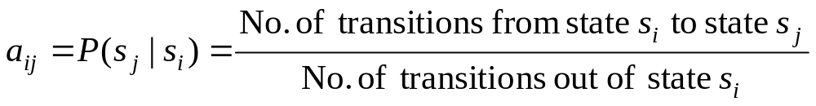
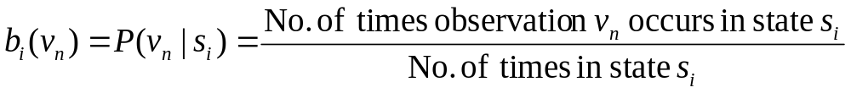
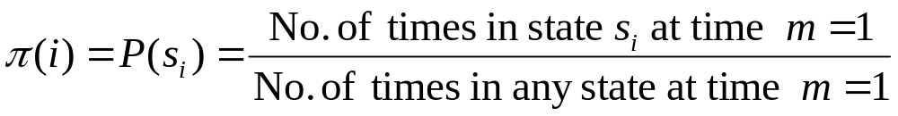
Learning/Training Problem
we need to calculate the following parameters:

Slide 66
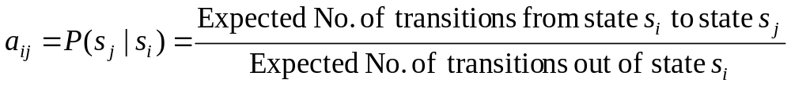
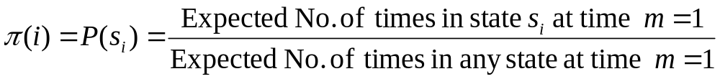
Baum-Welch algorithm
the algorithm estimates the expected value::

Slide 67
Baum-Welch algorithm
Define variable ξ_{m}(i,j) as the probability of being in state s_{i} at time m and in state s_{j} at time m+1, given the observation sequence o₁ o₂ ... o_{K} .
ξ_{m}(i,j)= P(q_{m}= s_{i} , q_{m+1}= s_{j} | o₁ o₂ ... o_{K})

Slide 68
Baum-Welch algorithm
Define variable ξ_{m}(i,j) as the probability of being in state s_{i} at time m and in state s_{j} at time m+1, given the observation sequence o₁ o₂ ... o_{K} .
ξ_{m}(i,j)= P(q_{m}= s_{i} , q_{m+1}= s_{j} | o₁ o₂ ... o_{K})
P(q_{m}= s_{i} , q_{m+1}= s_{j} , o₁ o₂ ... o_{K})
P(o₁ o₂ ... o_{K})
ξ_{m}(i,j)=

Slide 69
Baum-Welch algorithm
Define variable ξ_{m}(i,j) as the probability of being in state s_{i} at time m and in state s_{j} at time m+1, given the observation sequence o₁ o₂ ... o_{K} .
ξ_{m}(i,j)= P(q_{m}= s_{i} , q_{m+1}= s_{j} | o₁ o₂ ... o_{K})
P(q_{m}= s_{i} , q_{m+1}= s_{j} , o₁ o₂ ... o_{K})
P(o₁ o₂ ... o_{K})
ξ_{m}(i,j)=
P(q_{m}= s_{i} , o₁ o₂ ... o_{m}) a_{ij} b_{j} (o_{m+1} ) P(o_{m+2} ... o_{K} | q_{m+1}= s_{j} )
P(o₁ o₂ ... o_{K})
=

Slide 70
Baum-Welch algorithm
Define variable ξ_{m}(i,j) as the probability of being in state s_{i} at time m and in state s_{j} at time m+1, given the observation sequence o₁ o₂ ... o_{K} .
ξ_{m}(i,j)= P(q_{m}= s_{i} , q_{m+1}= s_{j} | o₁ o₂ ... o_{K})
P(q_{m}= s_{i} , o₁ o₂ ... o_{m}) a_{ij} b_{j} (o_{m+1} ) P(o_{m+2} ... o_{K} | q_{m+1}= s_{j} )
P(o₁ o₂ ... o_{K})
=
α_{m}(i) a_{ij} b_{j} (o_{m+1} ) β_{m+1}(j)
P(o₁ o₂ ... o_{K})
=

Slide 71
Baum-Welch algorithm
Define variable γ_{m}(i) as the probability of being in state s_{i} at time m, given the observation sequence o₁ o₂ ... o_{K} .
γ_{m}(i)= P(q_{m}= s_{i} | o₁ o₂ ... o_{K})
P(q_{m}= s_{i} , o₁ o₂ ... o_{k})
P(o₁ o₂ ... o_{k})
α_{m}(i) β_{m}(i)
P(o₁ o₂ ... o_{k})
γ_{m}(i)=
=

Slide 72
Baum-Welch algorithm
We calculated ξ_{m}(i,j) = P(q_{m}= s_{i} , q_{m+1}= s_{j} | o₁ o₂ ... o_{K})
and γ_{m}(i)= P(q_{m}= s_{i} | o₁ o₂ ... o_{K})
Expected number of transitions from state s_{i} to state s_{j}
= Σ_{m} ξ_{m}(i,j)
Expected number of transitions out of state s_{i} = Σ_{m} γ_{m}(i)
Expected number of times observation v_{n} occurs in state s_{i} =
= Σ_{m} γ_{m}(i) , m is such that o_{m}= v_{n}

Slide 73
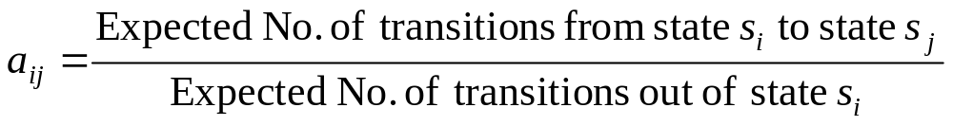
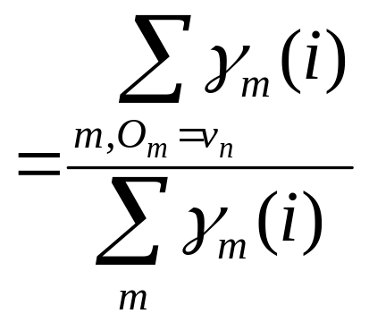
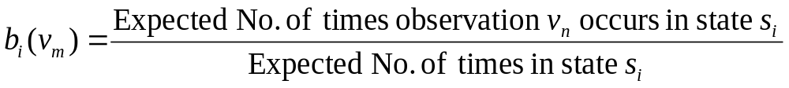
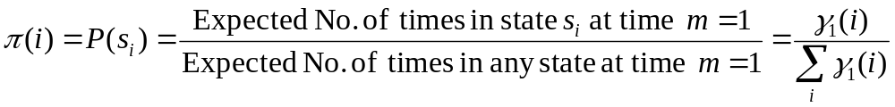
Baum-Welch algorithm: E-Step
Estimate the expected values as
Σ_{m} ξ_{m}(i,j)
Σ_{m} γ_{m}(i)
=

Slide 74
Learning/Training Algorithm
Initialization: Assume initial value of A, B, π
and calculate P(O | M)
E-step:
Estimate new values of the model parameters: A, B, π
from the previous values of A, B, π
M-step:
Find P(O | M) with the new values of A, B, π
Repeat these steps until P(O | M) declines

